Slide 1
DesIGN A MACHINE LEARNING SOLUTION
Hasan AVCI
INZVA – APPLIED AI #7

Slide 2
Understand THE PROBLEM AND ASK QUESTIONS
« As a Machine Learning Engineer/ Data Scientist you have to manage your stakeholder to take the right decision. You need to ask the right questions to both stakeholders and yourself and come up with data-driven decisions.»
Main Questions:
Is the stated problem is a real problem or something need to be assesed with a different pair of eye?
If it is a problem, could it be solved via basic automation, or any sophisticated method is required?
What is the easiest way to solve it?
What are success criteria and expected results?
What is the expected net value from the Project?
Why am i doing that?
How should i do that? ….

Slide 3
DESIGN YOUR SOLUTION
« You have to create a scalable product that is good enough to solve to problem. There could be a model ‘bad’ for a different task but ‘good’ for your specific task.»
An ML Product has to be:
Good enough.
Needs to be evaluated with proper metrics.
Have to be scalable and sustainable.
Needs to be convincing for every participant in the Project.
Have to be planned, tracked, and documented well.

Slide 4
WHY NOT SOTA MODELS FIRST
« Because of the things on the previous slide ☺.
You never use a bulldozer for a place you can dig with a shovel »

Slide 5
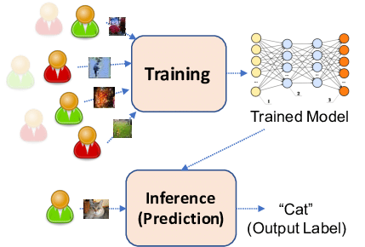
DEVELOPMENT vs INFERENCE
Purpose
Data Usage
Frequency of Updates
Hardware and Deployment
Monitoring and Maintenance:
Scalability
Resources

Slide 6

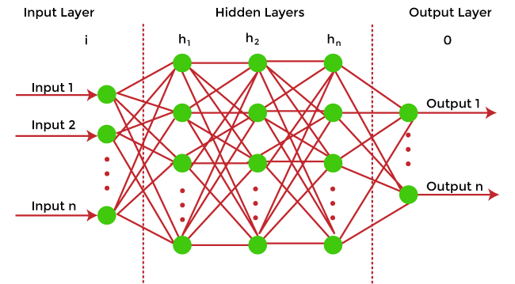
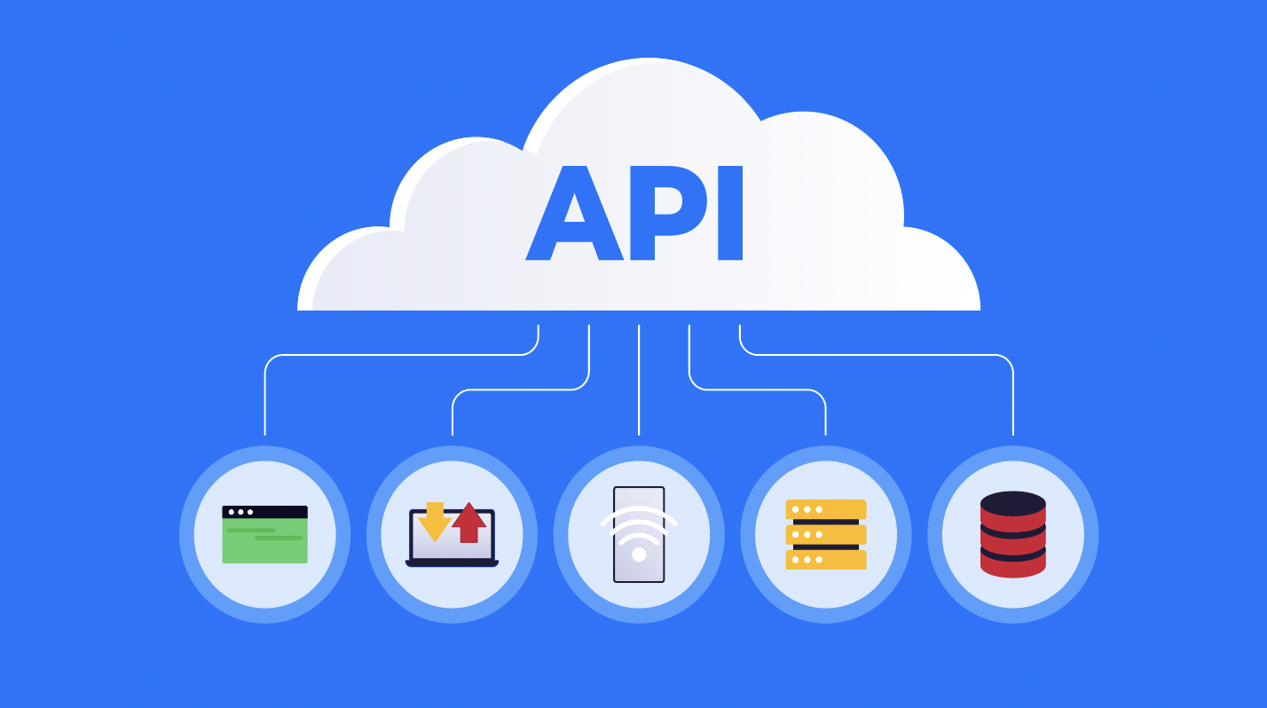
Same Model Dıfferent Metrıcs
Key Performance Indicators (KPIs), ROI (Return on Investment), Conversion Rates, User Engagement etc..
Accuracy Metrics, Loss Functions,
Bias and Fairness Metrics …
Latency and Response Time, Error Rates, Availability, SLI s, SLO s, Scalibility etc.

Slide 7








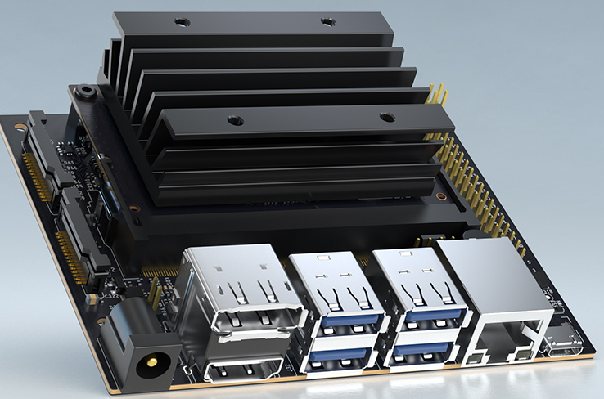

Implementatıon scenarıos

Slide 8
Case STUDY
HOSPITAL CASE STUDY

